Slide 1
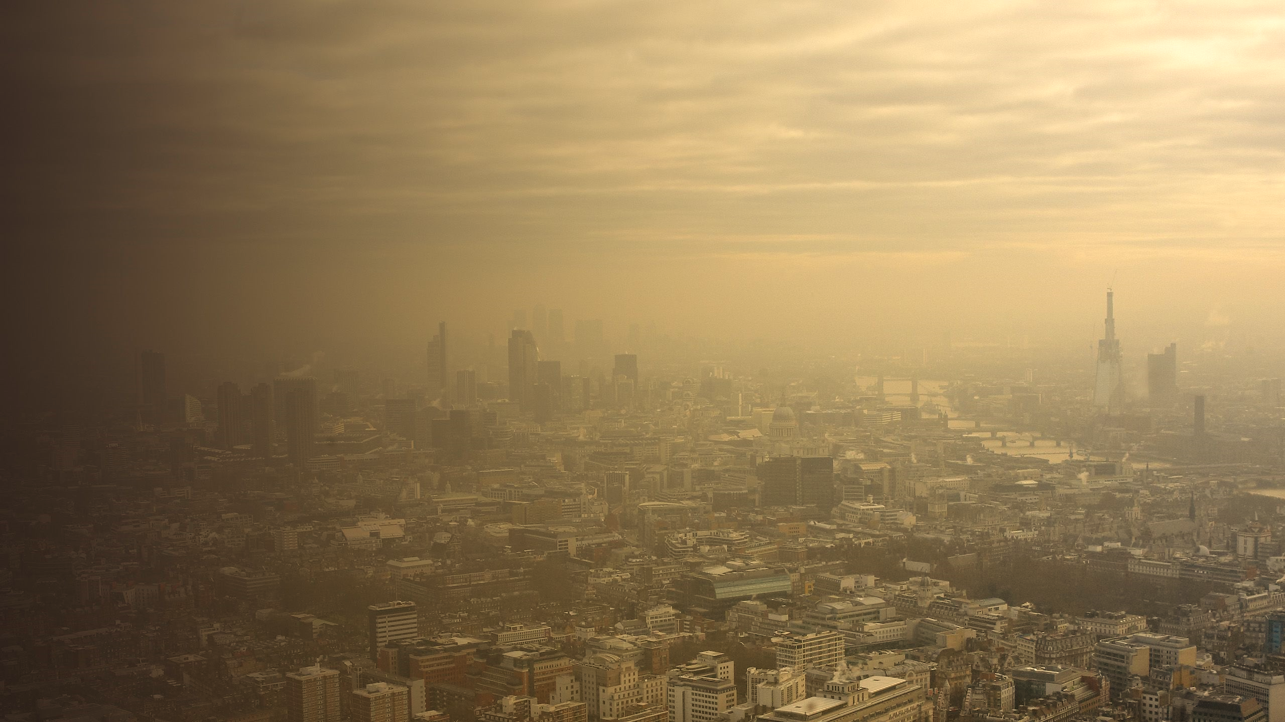
Public Perception, Health Impact and Behavioral Responses to Air Pollution

Slide 2

Ali Haider BSDSF22A012
Durrab Jah BSDSF22A017
Talha Anjum BSDSF22A019

Slide 3
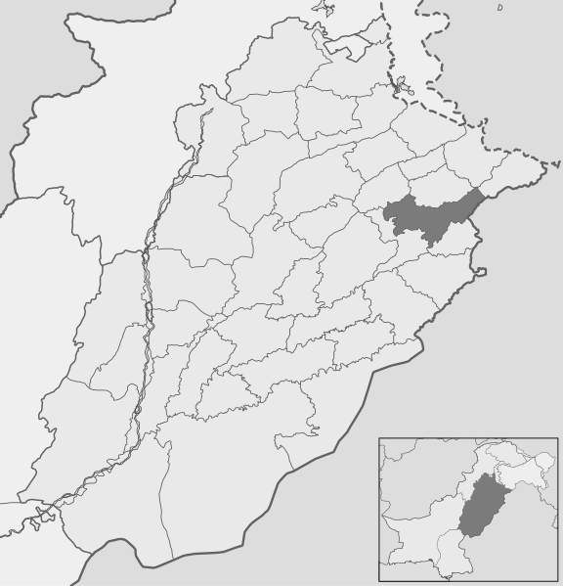

From where I collect data
The image on right side describe this
Sheikhupura
Lahore
Total sample=133

Slide 4
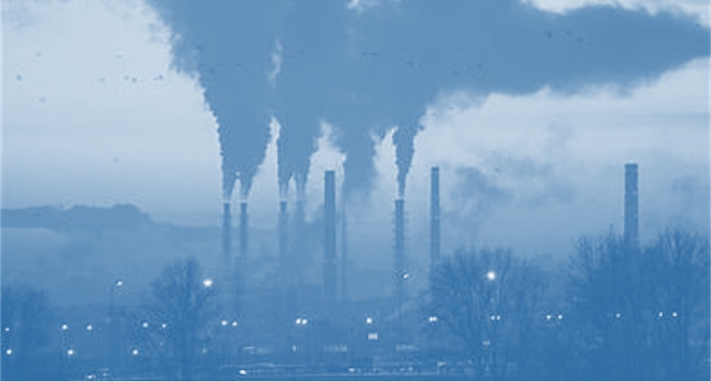

Why we choose this topic?
To understand how air pollution affects public health, awareness, and behavioral adaptations, providing insights for better interventions.
To explore public perception and support for policies addressing air quality, emphasizing the need for actionable change.

Slide 5
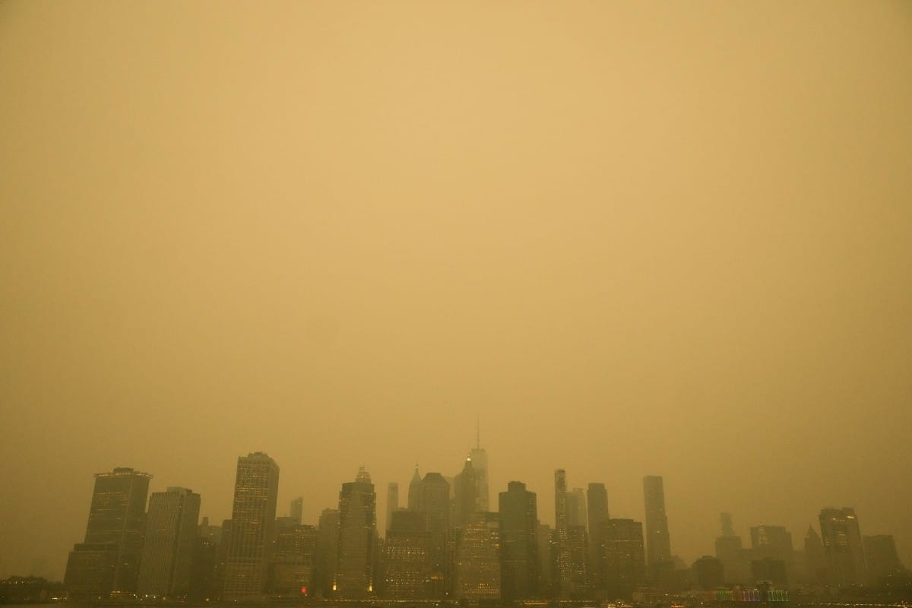
Questions
What is your age?
What is your gender?
What is your Employment Status?
How would you rate the overall air quality in your area?
Over the past 5 years, has the air quality in your area?
Do you think the government is doing enough to improve air quality?
Have you experienced any of the following health symptoms due to air pollution?
Do you believe the air quality affects your ability to work or study?
Have you visited a doctor or health professional due to air quality related health issues?
Are you aware of the Air Quality Index (AQI) and its implications?
Do you take any precautions when air quality is poor?
Would you support stricter government regulations to reduce air pollution?
Do you avoid outdoor activities during periods of poor air quality?
How often do you check the air quality before going outside?
In your opinion, what is the main cause of air pollution?

Slide 6
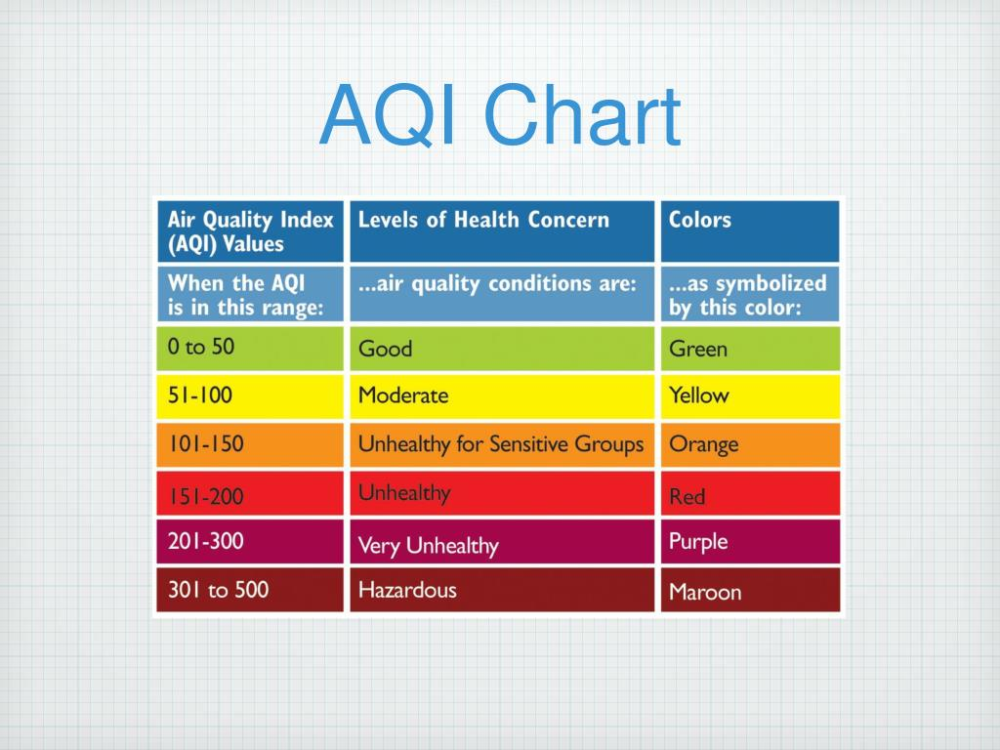

Slide 7
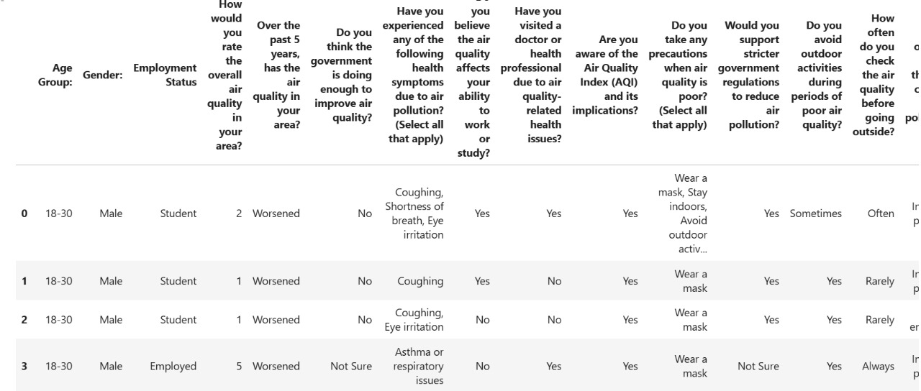
This is the fews rows and columns of our dataset.

Slide 8
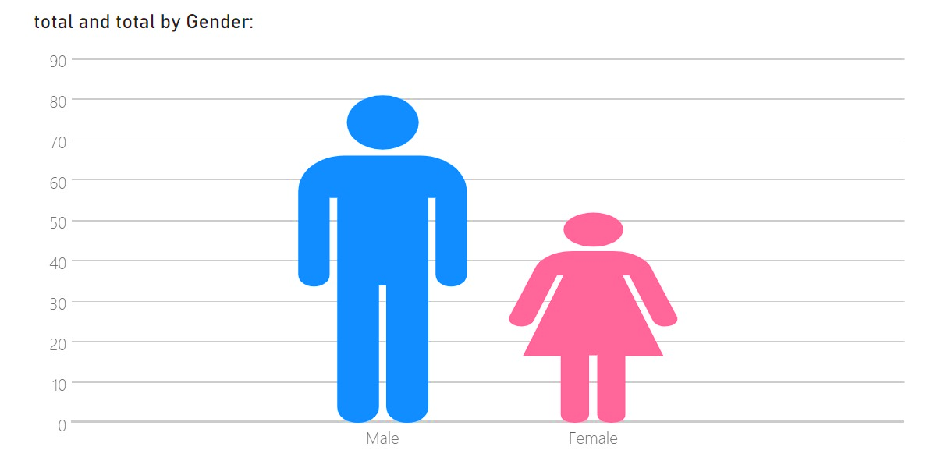
Percentage distribution of gender involved
60.9%
30.1%

Slide 9
Percentage distribution of age involved

Slide 10
Graphs showing gender distribution and people opinion towards Govt Performance

Slide 11

Chi-Square
Hypothesis
$H_{0}$ : There is no association b/w Gender and people opinion.
$H_{1}$ : There is assocaition b/w Gender are people opinion
Chi-Square statistics: 3.83
Degrees of freedom: 3
p-value: 0.27
p-value < 0.05 (False)
We fail to reject null hypothesis because there is no association between them.

Slide 12
Distribution of AQI Awareness

Slide 13

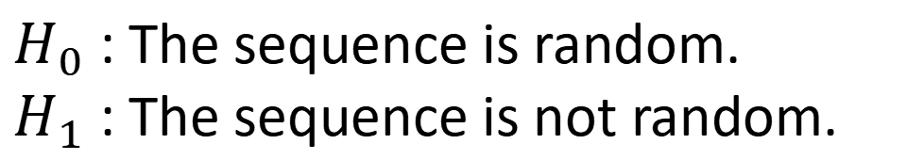
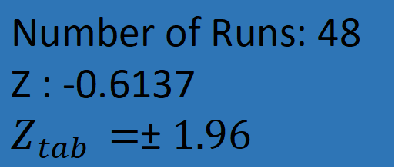
Runs test for randomness
Check randomness in AQI awareness responses.
$H_{0}$ : The sequence is random.
$H_{1}$ : The sequence is not random.
Number of Runs: 48
Z : -0.6137
$Z_{tab }=±1.96$
The z-value -0.6137 lies inside the $±1.96$ .
The sequence is random.

Slide 14
Graphs showing Distribution of Profession and Air Pollution in your area during the the past 5 years
Profession

Slide 15
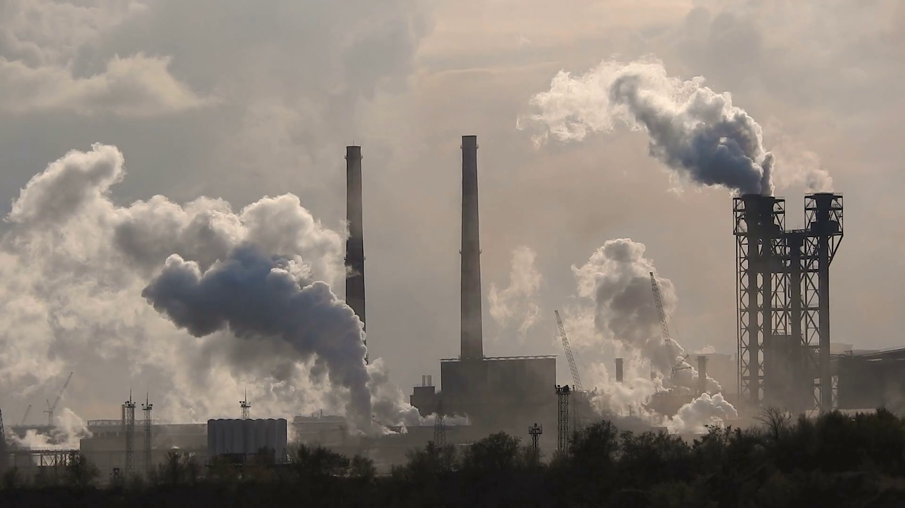
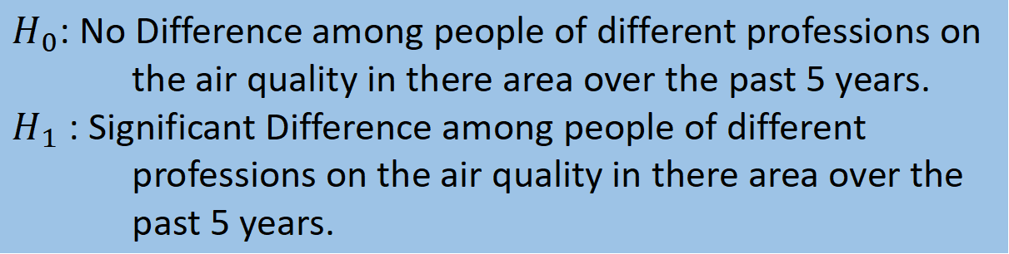
Kruskal-Wallis Test
$H_{0}$: No Difference among people of different professions on the air quality in there area over the past 5 years.
$H_{1}$ : Significant Difference among people of different professions on the air quality in there area over the past 5 years.
Kruskal-Wallis Statistic: 0.6930433968595375 p-value: 0.7071434752177674
H $>Critical Value$(False)
Fail to reject null hypothesis. No Difference among pepole of different professions on the air quality in there area over the past 5 years

Slide 16
Graphs showing distribution of AQI and affects on study or work
Affects on study or work

Slide 17
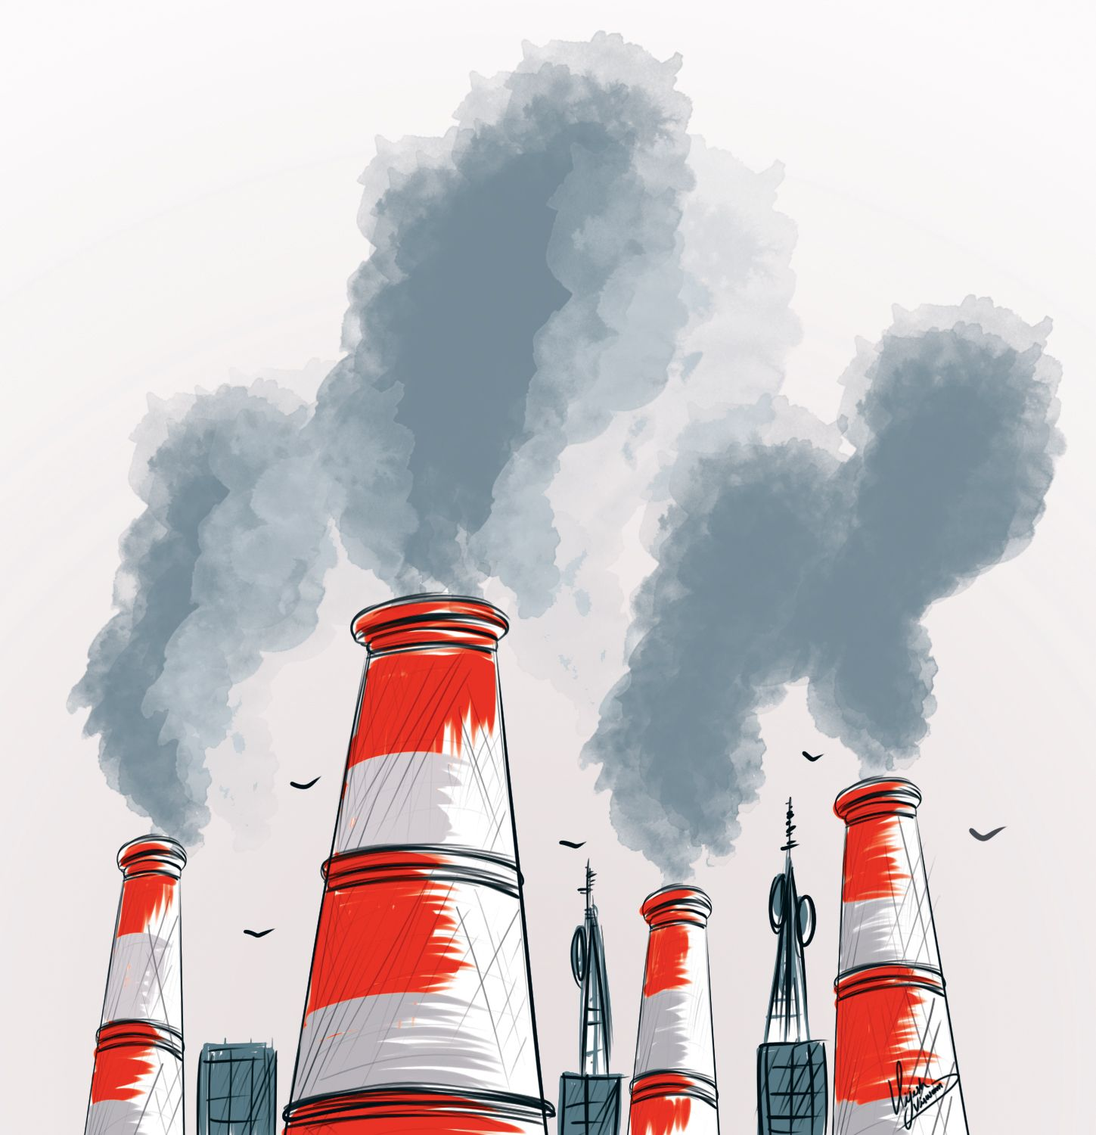

Hypothesis
$H_{0}$ : There is no association b/w AQI and its impacts on study or work.
$H_{1}$ : There is association b/w AQI and its impacts on study on work.
Chi-square statistics: 20.41
P-value: 0.0086
Degrees of freedom: 8
p-value $<$ $0.05$ (True)
We reject null hypothesis, there is a significant association b/w AQI and its slides.

Slide 18
Graphs showing the distribution of Precautions and Symptoms

Slide 19
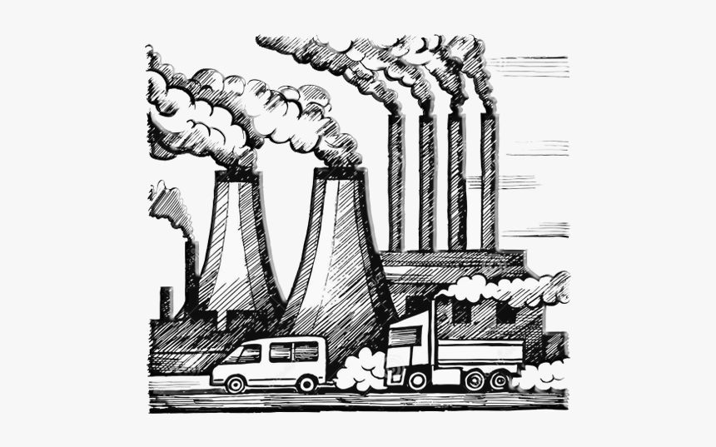
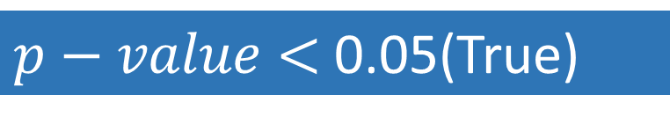
Chi-Square
$H_{0}$ : There is no association between precautions and symptoms
$H_{1}$ : There is association between precautions and symptoms
Chi-Square: 477.7
P-value: 5.5168e-05
Degrees of freedom: 364
$p−value$ $<$ 0.05(True)
We reject the null hypothesis, there is significant association between precautions and symptoms.

Slide 20
Distribution of Profession

Slide 21

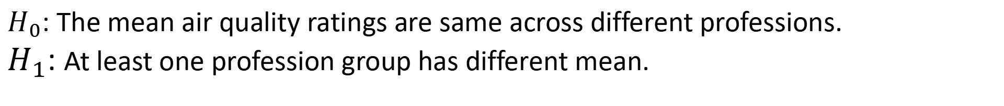

ANNOVA
$H_{0}$: The mean air quality ratings are same across different professions.
$H_{1}$: At least one profession group has different mean.
F-Statistics: 1.812
p-value: 0.16
$p−value$ $<$ 0.05(False)
From Calculation we fail to reject null hypothesis and so the mean of air quality across different professions are same.

Slide 22
Graphs showing gender distribution and people’s satisfaction towards Government Performance

Slide 23
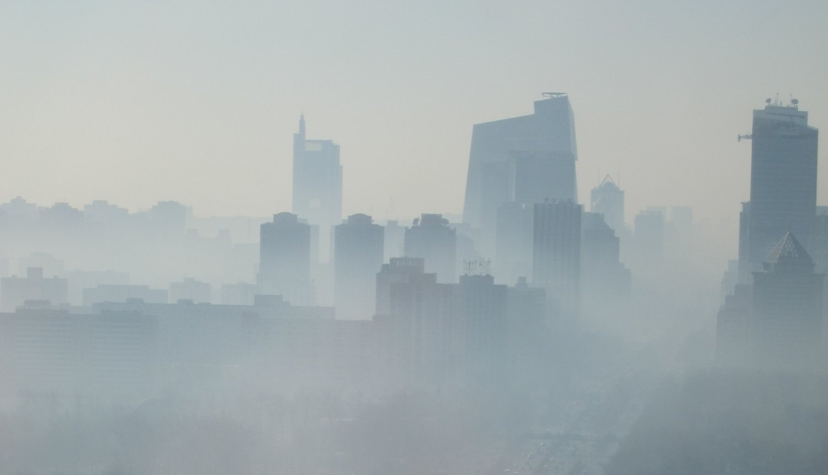

Hypothesis
$H_{0}$ : No Difference between genders opinion about government performance in reducing air pollution
$H_{1}$ : Significant Difference between genders opinion about government performance in reducing air pollution
Wilcoxon Rank-Sum Statistic: 0.4045028947905076
p-value: 0.6858429496142153
P_value < 0.05(False)
We fail to reject null hypothesis. No Difference between genders opinion about government performance in reducing air pollution

Slide 24
Distribution of Gender and Air Quality Rating
Air Quality Ratings
Gender

Slide 25

Wilicoxon rank-sum statistics
Compare Air Quality ratings between males and female
$H_{0}$: Two samples are from the population with same median
${ H}_{1}$: Two samples are from the population with different median
Statistics: -0.929
P-value: 0.652
No difference between genders

Slide 26


Slide 27
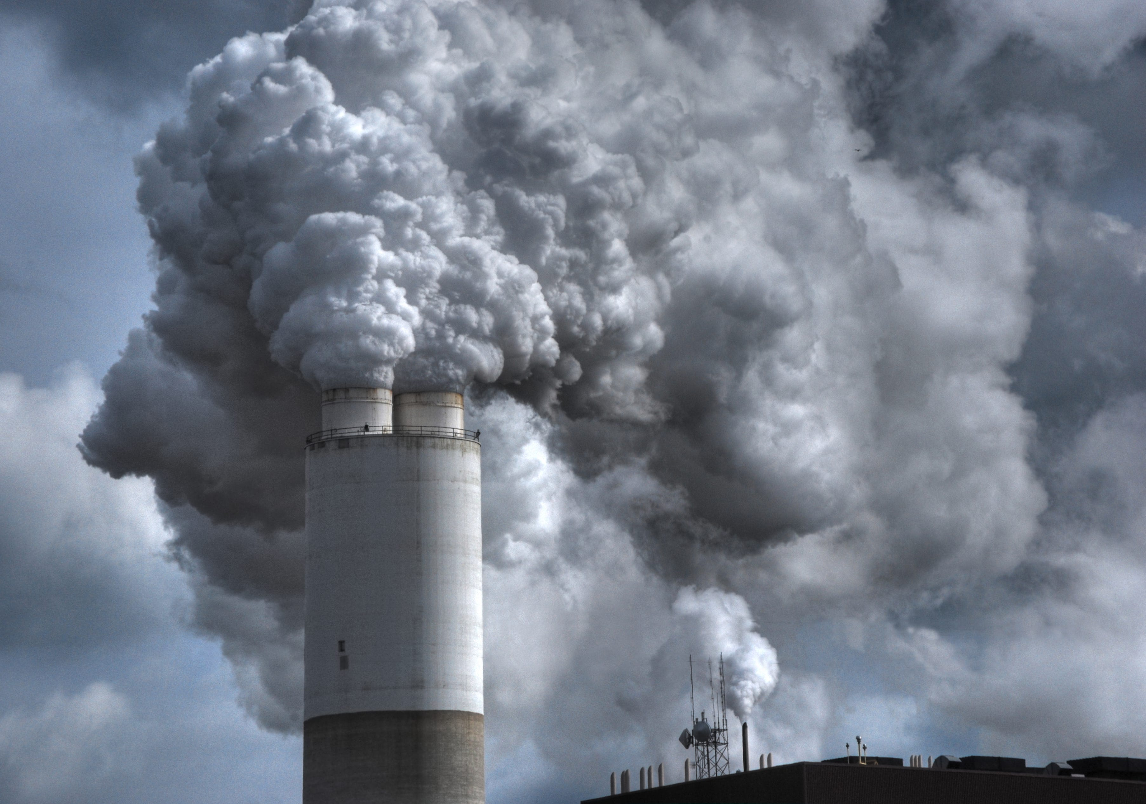

Air pollution significantly impacts health, especially for those taking fewer precautions.
Many people are aware of air pollution but lack full understanding of AQI.
Public views on government efforts to reduce pollution are similar across genders.
Most people adapt behaviors like avoiding outdoor activities during poor air quality.
Air quality perceptions are consistent across different professions.
Stricter regulations and awareness campaigns are crucial to improving air quality.

Slide 28


